Slide 1
ENSURING TRUSTWORTHY WASTE SEGREGATION WITH AI
Kakul Gupta
Pragya Arora
Noor Yeshfeen
Raman Sharma

Slide 2
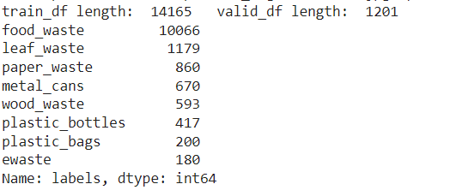
DATASET
The dataset has been chosen from Kaggle. It consists of images divided into 8 categories which are as follows:
Food waste
Paper Waste
E-waste
Plastic Bags
Plastic Bottles
Metal Cans
Wood Waste
Leaf Waste

Slide 3
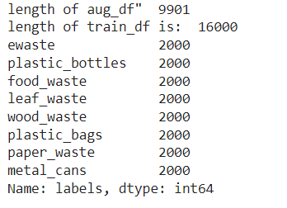
DATA AUGMENTATION
The dataset is augmented for balancing all the categories of images by using horizontal flip, vertical flip, rotation, width shift, height shift and zoom.
Following code is used:
gen=ImageDataGenerator(horizontal_flip=True, vertical_flip=True, rotation_range=20, width_shift_range=.2, height_shift_range=.2, zoom_range=.2)

Slide 4
CNN
Hyperparameters used in CNN:
Early Stopping : patience = 5, mode = max, verbose = 1
No. of layers : 3
Layers :
Convolution layer : filters = 64(layer1), 32(Layer 2 and layer 3), strides = 2, kernel = 3,
Batch Normalization
Activation: RelU
MaxPool Layer : strides = 2
Regularization : L2
Optimizer : Adam
Loss : Categorical Crossentropy

Slide 5
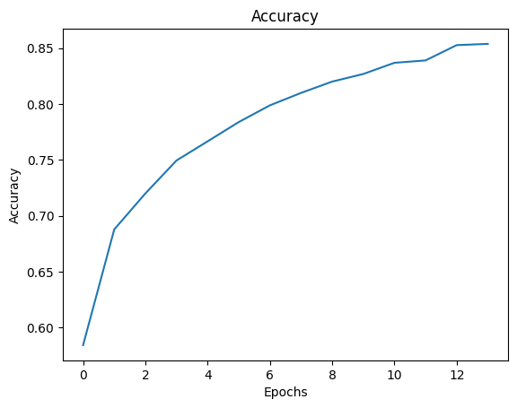
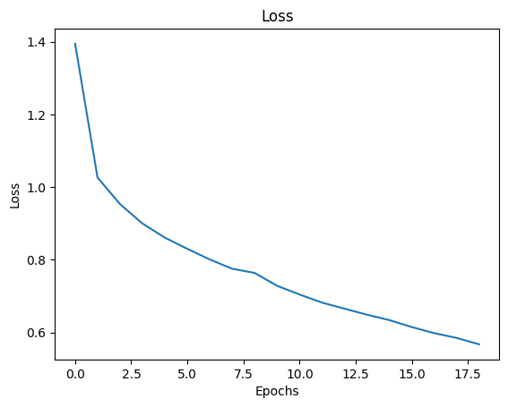
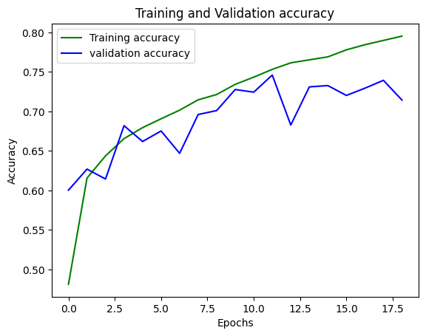
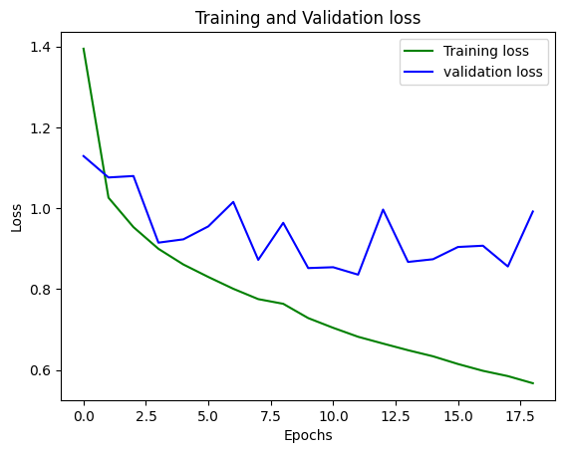
RESULTS

Slide 6
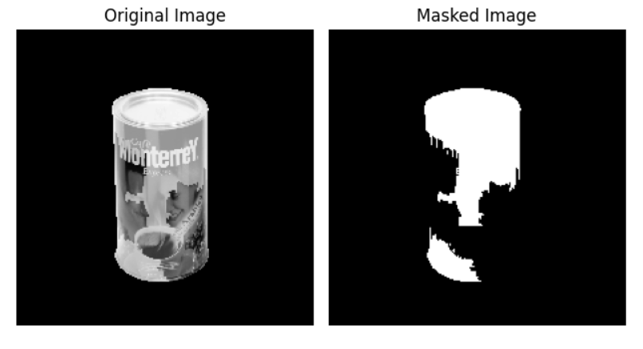
EXPLAINABILITY
LIME:
LIME: LIME stands for Local Interpretable Model-agnostic Explanations. It is a Python library based on a paper from Ribeiro et al. to help you understand the behavior of your black-box classifier model.
Model agnostic, which means that LIME is model-independent. In other words, LIME is able to explain any black-box classifier you can think of.
Interpretable, which means that LIME provides you a solution to understand why your model behaves the way it does.
Local, which means that LIME tries to find the explanation of your black-box model by approximating the local linear behavior of your model.

Slide 7
EVALUATION METRIC FOR LIME : FIDELITY
A high-fidelity LIME explanation means that the interpretable model closely matches the behavior of the black-box model in the vicinity of the data point under consideration. In contrast, low fidelity would indicate that the interpretable model fails to capture the black-box model's decision boundaries accurately, leading to potentially misleading or incorrect explanations. The value of fidelity came to be 70%

Slide 8
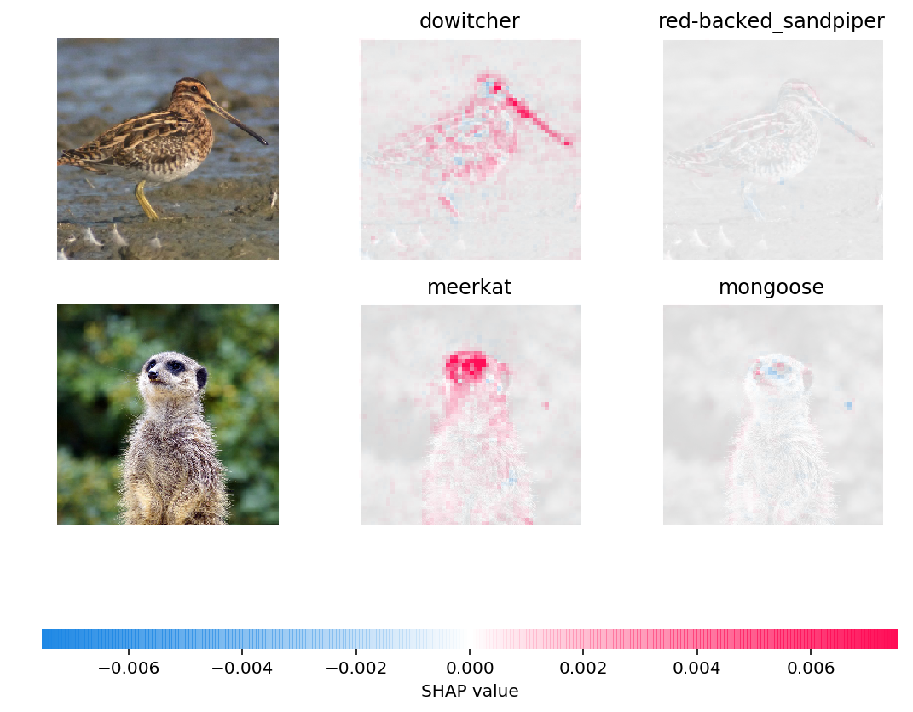
SHAP
SHAP (SHapley Additive exPlanations) for images is a method that helps us understand why a machine learning model makes specific predictions for pictures. It provides explanations for individual image predictions, telling us which parts of the image were most important in influencing the model's decision.
In this visualization:
Red pixels represent positive SHAP values that contributed to classifying that image as that particular class.
Blue pixels represent negative SHAP values that contributed to not classifying that image as that particular class.

Slide 9
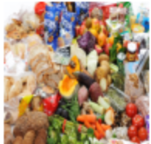
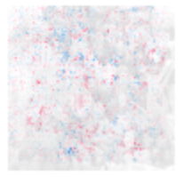
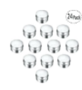
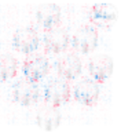
RESULTS
Fidelity : 0.7

Slide 10
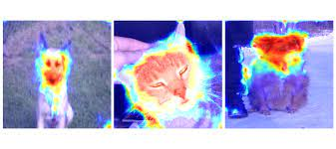
GRAD CAM
Grad-CAM (Gradient-weighted Class Activation Mapping) is a visualization technique used to understand and interpret the decision-making process of Convolutional Neural Networks (CNNs) in computer vision tasks, such as image classification. It highlights the regions in an input image that are most important for the model's prediction of a particular class.
In image classification, CNNs consist of multiple layers that extract features from the input image. The final layers of the network are typically responsible for making the actual prediction. Grad-CAM operates on these final layers and produces a heatmap that highlights the regions in the input image that contribute the most to the prediction of a specific class.

Slide 11
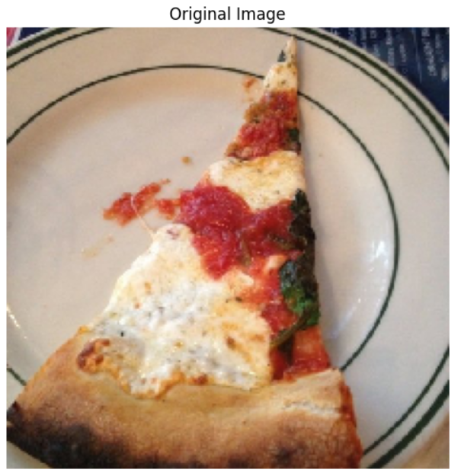
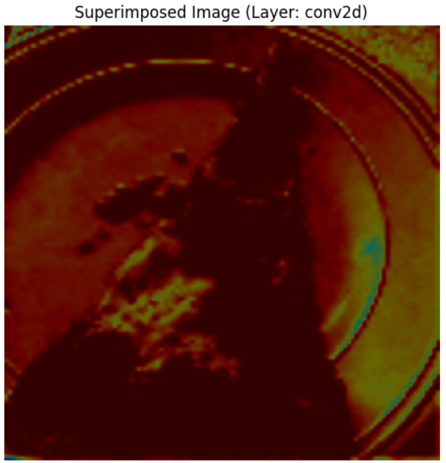
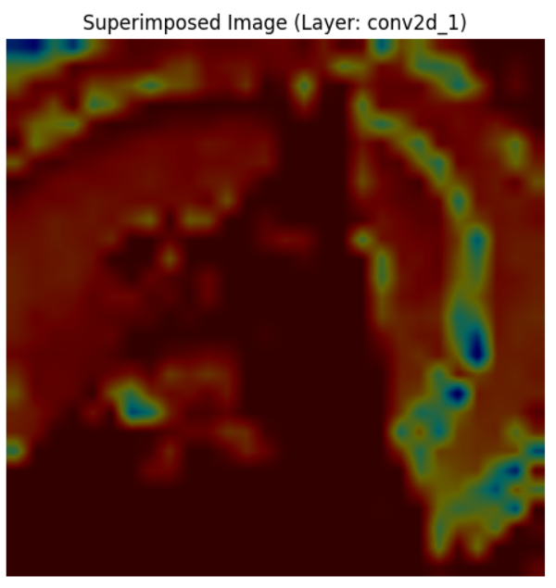
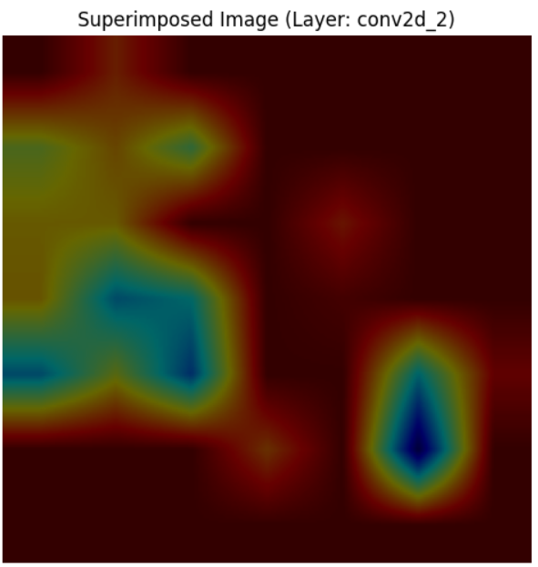
RESULTS

Slide 12
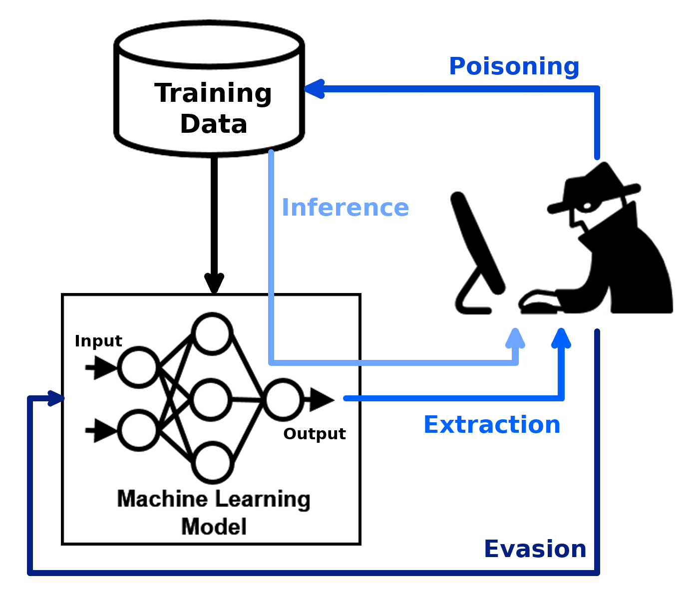
ROBUSTNESS
It refers to a model's ability to maintain performance and generalization under adversarial attacks or perturbations in input data.
ART is a toolkit designed to assess, enhance, and evaluate the robustness of machine learning models against adversarial attacks.
FGSM is an adversarial attack technique used to quickly generate adversarial examples by perturbing input data in the direction of the loss gradient.
The C&W (Carlini and Wagner) attack is an optimization-based technique used to generate highly effective and imperceptible adversarial examples against machine learning models.

Slide 13
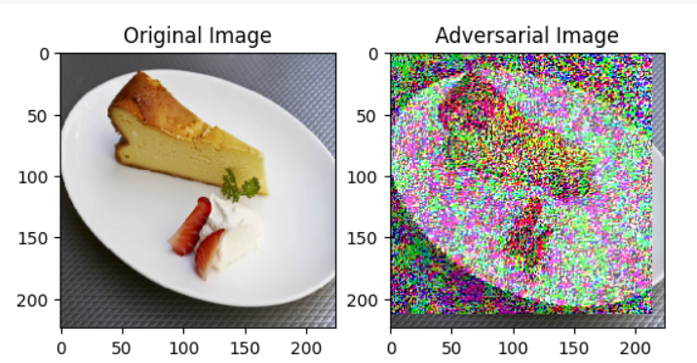
RESULTS
Image after adding perturbation of eps = 0.5
Clean Accuracy: 0.71875
Adversarial Accuracy: 0.146875
Clean Loss: 0.125
Adversarial Loss: 0.12499998

